Slide 1
Unit – 1
Introduction
Database Systems
Asif Sohail
University of the Punjab
Punjab University College of Information Technology (PUCIT)

Slide 2
Text & Reference Books
Database Systems – Design, Implementation and Management: Carlos Coronel, Steven Morris (13th Ed.)
Modern Database Management: Jeffery. A. Hoffer (11th Ed.)
Database Systems: Thomas M. Connolly (6th Ed.)
Fundamentals of Database Systems: Elmasri (7th Ed.)
An Introduction to Database Systems: C.J. Date (8th Ed.)
Introduction to PL\SQL: Oracle Press

Slide 3
Course Information
Resources:
\\printsrv\\teacher data\\Asif Sohail\\Database Systems
Office: (Ground Floor) Graduate Building
Students Counseling hours :
  Tue, Thr: 11:00 – 12:30 P.M
email: asif@pucit.edu.pk
Assessment Category | Marks
Quizzes | 14
Assignments | 6
Project | 5
Notes:
Dbsrv contains following
Dr Mansoor Lecture Hand outs
Linux Red Hat CDs
Linux Tutorial
Vm ware

Slide 4
Outline
Introduction
Data? Information? Database?
File Processing System (FPS)
Drawbacks of FPS
Database System or Integrated Database Environment(IDE)
Advantages of IDE
Types of Databases

Slide 5
Introduction
Dunn's Book of Life (1946)
Each person in the world creates a Book of Life. This Book starts with birth and ends with death. Its pages are made up of the records of the principal events in life. Database/Record linkage is the name given to the process of assembling the pages of this Book into a volume."

Slide 6
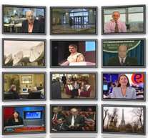





Introduction
Increasing need of database systems
The Model of Generating/Consuming Data has Changed
Old Model: Few companies are generating data, all others are consuming data
New Model: all of us are generating data, and all of us are consuming data

Slide 7
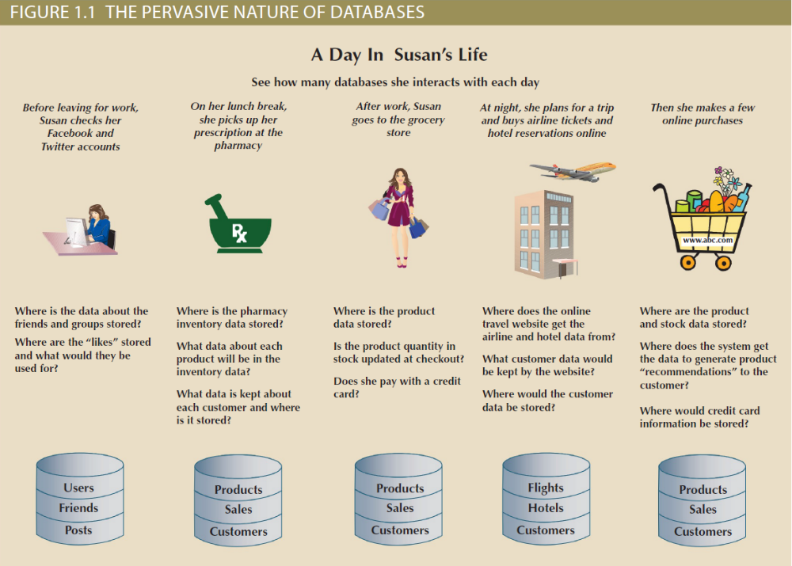

Slide 8
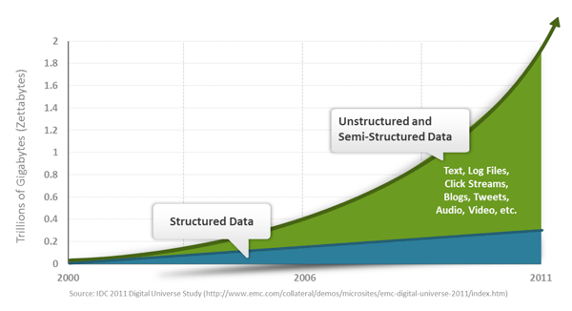
Exponential Data Growth

Slide 9
Data
Data refers to the raw facts & figures concerning:
  PEOPLE
  EVENT
  ORGANISATION
  OBJECT
The amount of available data in the modern computer world is literally exploding (3 Vs: Volume, Velocity, Variety)
The modern data sources/types include multimedia data, sensor’s data, data on web and so on.
To get most out of data, we require tools than can simplify the task of managing the data and extract useful information out of it in timely fashion.

Slide 10
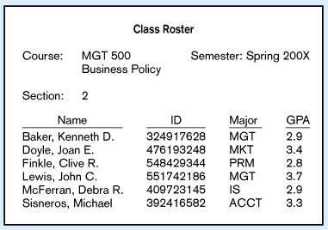
Data
Large volume of facts, difficult to interpret or make decisions based on

Slide 11
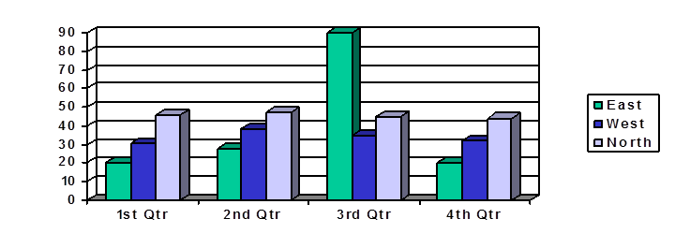
Data vs Information
Information is derived from data OR Information is the processed data
Information may be presented either Textually or Graphically or both
The representation and amount of information depends upon the requirements of a user.
When data is processed and organized into a form needed for its application, it is called an Information Product (IP).

Slide 12
Data vs Information
Accurate, reliable, relevant and timely information is key to good decision making.
Information is now increasingly viewed as an organizational asset (Redman, 2008) which can be used to improve organizational performance and help an organization gain a competitive advantage in the marketplace.

Slide 13
Data Hierarchy
Field (Data Item)
Record
File
Database

Slide 14
Database
Database System can simply be regarded as a computerized record keeping system.
Database System is a system whose overall purpose is to maintain data and make the information available to its users as per their requirements.
The user of the system can perform the operations like:
  Defining structure and types of data
  Data manipulation (Insert, Delete, Update, Query etc.)
  Enforcing security restrictions
A Database Management System (DBMS) is a collection of programs that manages the database structure and controls access to the data stored in the database.

Slide 15
Database
Database is a shared collection of logically related data, and a description of this data, designed to meet the information requirements of multiple users in an organization.
Database is an organized collection of data (and metadata) about entities and the relationships among these entities.
Metadata: Data that describes properties or characteristics of other data OR it is “data about data”.
The description of data is also known as system catalog or data dictionary.
Metadata allows database designers & users to understand what data exists and what the data mean?
Metadata describes the domain (set of possible values) and the constraints for a data item.

Slide 16
Metadata Example
Data Item |  | Value
Name | Type | Length | Min | Max | Description
Course | Alphanumeric | 30 |  |  | Course ID & Name
Section | Integer | 1 | 1 | 9 | Section Number
Semester | Alphanumeric | 10 | 1 | 8 | Semester & Year
Name | Alphanumeric | 30 |  |  | Student name
ID | Integer | 9 |  |  | Student ID
Major | Alphanumeric | 4 |  |  | Student Major
GPA | Decimal | 3 | 0.0 | 4.0 | Student GPA

Slide 17
Examples of Database Applications
Databases play a critical role in almost all areas where computers are used.
Databases are everywhere …
  Student / Employee’s Information System
  Library System
  Hotel / Airline Reservation System
  Billing System
  Stock / Inventory System
  Payroll System
  Geographical Information Systems (GISs)
  Data Warehouses

Slide 18
Record Keeping Techniques
Manual Record Keeping.
Computerized Record Keeping
  File Processing System.
  Database System or Integrated Database Environment. (The paradigm shift)

Slide 19
Case Study
Consider a College System consisting of the following offices:
  Admission Office
  Academics Office
  Exam Office
Each Office is maintaining its own set of files for its day to day operations.
Some of the files used in the system are Student’s File, Faculty File, Course File, Correspondence File etc.

Slide 20
Manual System - Drawbacks
High data volume
Not reliable
Inefficient
Duplication of data
Inconsistency
A lot of data movement is required
The System can’t answer complex queries involving multiple departments.

Slide 21
File Processing System
File-based systems were an early attempt to computerize the manual filing system.
The manual files were replaced by computer files.
A person responsible for developing and managing computerized file processing system was called Data Processing (DP) specialist.
In the traditional file processing system, the existing manual system is automated by focusing on the data processing needs of the individual departments instead of treating the organization as whole.
Each application will have its own set of Private Files designed to meet the needs of a particular department.

Slide 22
File Processing System
File – 1
App – 1
(operations + data descriptions)
File – 2
App – 2
(operations + data descriptions)
File – n
App – n
(operations + data descriptions)

Slide 23
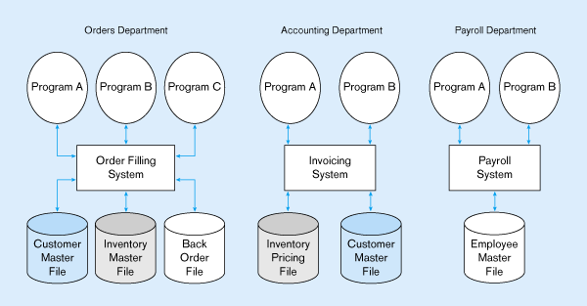
File Processing System
Duplicate Data

Slide 24
Drawbacks of File System
Redundancy of Data
Inconsistent Data
Poor Enforcement of Standards
Data Dependence
Limited Data Sharing
Fixed Queries
Inflexible
Lack of provision for security
Limited recovery from failure

Slide 25
Drawbacks of File System
1. Redundancy of Data
  Redundancy means duplication of data.
  Since applications in FPS are independent so unplanned duplicate data is there.
  Same information is needed to be kept at different places. It costs time and money.
  Same data may have to be input several times to update all the occurrences.
  Redundancy results in data anomalies (Insert, Update, Delete)

Slide 26
Drawbacks of File System
2. Data Inconsistencies or Data Anomalies
  Redundancy leads to data inconsistency or data anomalies.
  A data anomaly occurs if an operation (update, insert, delete) has not yet been performed against all the occurrences. Consequently, same data stored at different places will disagree with each other
  The use of different programming environment and platforms lead to Heterogeneous Environment.
3. Poor Enforcement of Standards
  Organization wide enforcement of standards is poor. This leads to the following types of inconsistencies:
  Synonym: Using different names for same data item
  Example: Stu-Id, Reg-No.
  b) Homonym: Using same name for different data items.
  Example: “course” for a single subject or entire program.

Slide 27
Drawbacks of File System
4. Data Dependence
The definition of data is embedded in the application programs, rather than being stored separately and independently.
The applications are constrained to work only with the given file description. Any change in the file structure or data requires changes to all the applications using that file. Such applications are called Data Dependent Applications.
Data dependence leads to excessive program maintenance.
Often difficult to locate all programs affected by change
Errors are often introduced when making changes.
Incompatible file structures (use of different programming languages) makes the situation even worse.

Slide 28
Drawbacks of File System
5. Limited Data Sharing
As each application has its own private files so little opportunity to share data with others.
The filing system works well when we have to interact with each file separately. However, it breaks down when we have to cross-reference or process the information in the files. This makes it hard to answer queries involving multiple files.
6. Inflexible: Fixed queries
7. Lack of provision for security
8. Limited recovery from failure

Slide 29
Integrated Database Environment(IDE)
The limitations of file-based approach can be attributed to the following factors:
  Redundancy of data
  Data dependence
In contrast to file processing system, the IDE has a single large repository of data, where data definition is separated from application programs.
Emphasizes the integration & sharing of data throughout the organization.
The organization wide requirements are analyzed as a whole and there is no longer concept of MY FILE or Private Files.
A Database Management System (DBMS) is a software designed to assist in maintaining and utilizing large collections of data.
By storing data in a DBMS rather than as a collection of files, we achieve enormous advantages.

Slide 30
Database System
Database
(Data + Data Descriptions)
D
B
M
S
App – 1 (Operations)
App – 2 (Operations)
App – n (Operations)
DBMS manages data resources like an operating system manages hardware resources

Slide 31
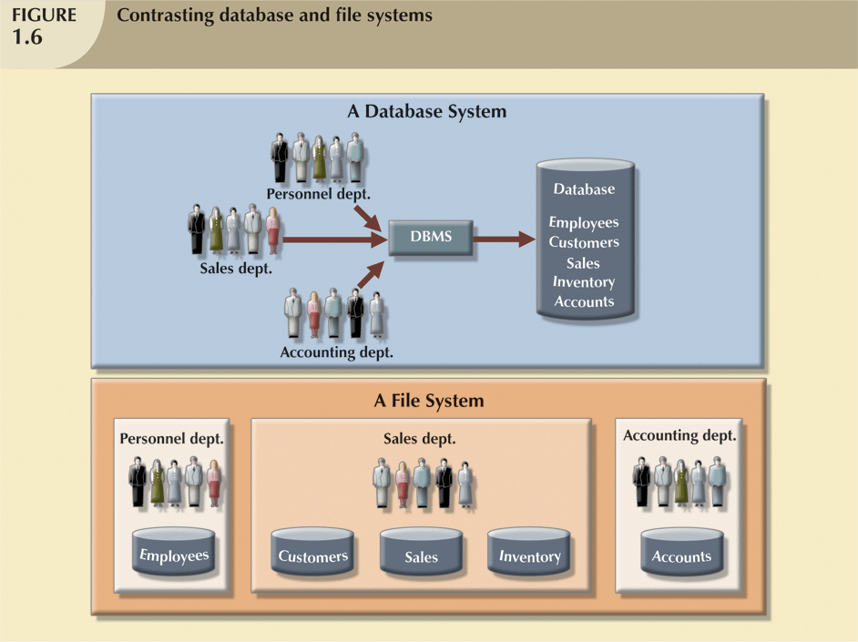


Slide 32
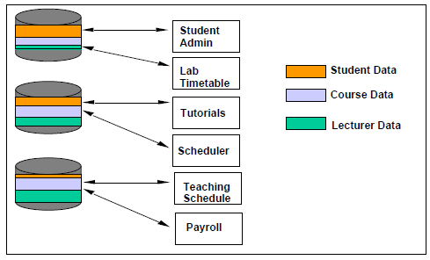
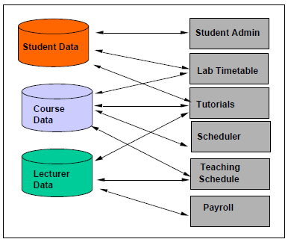
Contrasting Database and File System
File System
Database System
Adapted from Lecture slides of Werner Nutt

Slide 33
Advantages of Database Approach
Reduced or Controlled Data Redundancy
Improved Data Consistency
Enforcement of Standards
Reduced Program Maintenance
Data Sharing
Data Integrity (Improved Data Quality)
Improved Security Restrictions
Improved Accessibility & Responsiveness
Improved Decision Making
Efficient Query Processing
Backup & Recovery
Data Independence

Slide 34
Advantages of Database Approach
1. Reduced or Controlled Data Redundancy
  Since all the data items are stored in a single database, therefore Redundancy is minimized.
  Separate data files are integrated into a single, logical structure to reduce redundancy
  100% elimination of redundancy is not possible in order keep the logical connections among the data items.
2. Improved Data Consistency
  Reduction in redundancy automatically avoids inconsistency.
  Wang and Wand describes data consistency as “a data value can only be expected to be same for the same situation”.
  If a data item appears only once, any change to its value needs to be performed only for once and the database will always be in some consistent / correct state.

Slide 35
Advantages of Database Approach
3. Enforcement of Standards
This is possible as database is designed to meet the organization wide requirements.
The standards can be name of data items and their format, data codes, documentation standards, operation standards, security policies etc.
4. Reduced Program Maintenance & Development Cost
When all the organization’s requirements are satisfied by one database instead of many separate files, the maintenance and development cost automatically reduces.

Slide 36
Advantages of Database Approach
5. Data Sharing
Sharing means that the same data source is used by multiple applications.
Data is centralized and hence can be shared not only by the existing applications but also new applications can be developed to operate against the same data.
The applications that can access same data simultaneously are called Online Transaction Processing (OLTP) applications and DBMS uses Concurrency Control Mechanism to ensure that multiple users can access and update data correctly.

Slide 37
Advantages of Database Approach
6. Data Integrity (Improved Data Quality)
Data integrity refers to the correctness of data.
Integrity constraints or rules ensure that the data stored in the database is purified and accurate.
7. Improved Security Restrictions
Database security is the protection of database from unauthorized disclosure, alteration or destruction.
DBMS provides strong security measures against such threats. Some of them are:
  Password checks
  User defined procedures
  Defining user privileges
  Audit trial system
  Data encryption

Slide 38
Advantages of Database Approach
8. Improved Accessibility & Responsiveness.
In File Processing System, data accessibility is quite difficult as it is procedural based. You should know the detailed procedural steps. HOW TO DO?
On the other hand, accessing data is lot easier in DBMS with the help of a non procedural language – SQL. You only need to know the simple commands or in other words WHAT TO DO?
9. Improved Decision Making
Consolidated reports ➔base attribute
Ad-hoc queries ➔derived attribute
Multiple views of data

Slide 39
Advantages of Database Approach
10. Efficient Query Processing
Specialized data structures and search techniques
Indexing
Buffering or caching module
Query processing and optimization
11. Backup & Recovery
The backup and recovery subsystem of DBMS provides efficient techniques for database recovery.

Slide 40
Advantages of Database Approach
12. Data Independence.
The separation of data descriptions from the applications using the data is called data independence.
Data Independence can also be defined as: “The immunity of an application to change in storage structure – which implies that the applications don’t depend on any particular storage structure”.
Allows change & evolution of database systems without changing the application programs
Without data independence, it is must to understand the arrangements of data elements in order to perform an operation against them.
Different data arrangements will need different algorithms even for the same operation.

Slide 41
Advantages of Database Approach
12. Data Independence.
Clearly, data dependence is not desired because of the following reasons:
Each user should be able to access data in a customized way.
Users should not have to deal directly with the physical database storage details.
Different application may need different physical structure for the efficiency of their operations.
The DBA should have freedom to change the storage structure or access technique or both in response to changing requirements without much disturbing the existing applications.

Slide 42
Cost & Risk of Database Approach
Need for new specialized personnel
Installation cost & complexity
Conversion from legacy system to modern database system
Organizational conflict
Higher impact of failure
Maintaining currency
Not suitable for applications with tight real-time constraints

Slide 43
Types of Databases
Databases can be categories on the basis of the following criterions:
Criteria | Types
1. Number of users | Single User Database Multi-user Database
2. Data location | Centralized Database Distributed Database
3. Data usage | Operational (OLTP) Analytical (OLAP)
4. Form of data | Unstructured Structured Semi-structured (XML)

Slide 44
Types of Databases
Single user with desktop computer
Mainframe computer with thousands of users
Categories are:
  Personal computer databases(Single User)
  Workgroup databases(Multi-user)
  Department databases (Multi-user)
  Enterprise database (Multi-user)

Slide 45
Types of Databases
Personal Computer Databases
Support one user with a standalone PC
E.g. a student’s own database or a sales person’s simple database
Workgroup Databases
Workgroup: relatively small group of people who collaborate on same project/application.
A workgroup DB supports the collaborative efforts of a workgroup.
Allows data sharing.
Its model is shown on the next fig:

Slide 46
Continued…
LAN
DB Server
Workgroup
DB
Workgroup DB on LAN
(Method of Data Sharing)

Slide 47
Types of Databases
Department Databases
Department: Functional unit within an organization
Department DBs support function & activities of a department.
E.g. personnel DB to track employees, jobs, skills etc.
Enterprise Databases
DB scope is the entire organization
To support organization-wide operations & decision making.

Slide 48
Continued…
Hospital
Medical
Clinic
Corporate
Office
Hospital
Nursing
Home
Data Warehouse
Medical
Clinic

Slide 49
Types of Databases
Internet, Intranet & Extranet Databases
Internet: A worldwide network that connects users of multiple platforms easily through an interface known as web browser
Extranet: Use of Internet protocols to establish limited access to company data & information by the company’s customers & suppliers
Intranet: Use of internet protocol to establish access to company data and information that is limited to the organization
Centralized & Distributed Databases
Centralized database system – supports a database located at a single site
Distributed database system – supports a database distributed across several different sites

Slide 50
Types of Databases
The past few years have produced advances in technology leading to exciting new applications of database systems such as:
  Multimedia databases
  Geographic information systems
  Data warehouses
Multimedia databases – store pictures, video clips, and sound messages
Geographic information systems (GIS) – store and analyze maps, weather data, and satellite images
Data warehouses & on-line analytical processing (OLAP) is used to extract and analyze useful information from very large databases for decision-making.

Slide 51
Thank you for your attention.
Asif Sohail
Assistant Professor
University of the Punjab
Punjab University College of Information Technology (PUCIT)
Allama Iqbal (Old) Campus, Anarkali
Lahore, Pakistan
Tel: +92-(0)42-111-923-923 Ext. 154
E-mail: asif@pucit.edu.pk

